Slide 1


12:38
Screen Description and Purpose
This is first screen the user will see when interacting with the FindRoutes mapping android application, This screen is the login page which will be used for authentication purposes and the user will have to input correct credentials before they can access other application features.
The is a register button in the bottom of the screen for new users to register an account with the application before they can have access to the features of the application.
LOGIN
Username:
Password:
Login
Register Account here
Register

Slide 2
12:38
Screen Description and Purpose
When the user has clicked the register button, the user will be re-directed to this screen displayed on the left. The user must fill in all the information required then click proceed to create an account with the application. The user must remember the password and email they have registered with to successfully login into the application in the login screen.
The text-fields in this screen shall have validation, meaning there shall be a syntax that the user must comply to successfully create an account with the FindRoutes android mapping application.
Registration
Name
Surname
Email address must contain domain
Email
Password Must meet password complexity requirements
Password
Confirm Password
Proceed
Clear

Slide 3
12:38
Screen Description and Purpose
After the user has successfully registered an account with FindRoutes mapping android application, the user needs their account registered email address and password to successfully login into the application.
The login screen shall use validation to ensure that the user inputs values that are expected from the user in the login screen before authenticating the user for a successful login.
LOGIN
Email address must contain domain
Username:
email@gmail.com
Password Must meet password complexity requirements
Password:
************
Login
Register Account here
Register

Slide 4
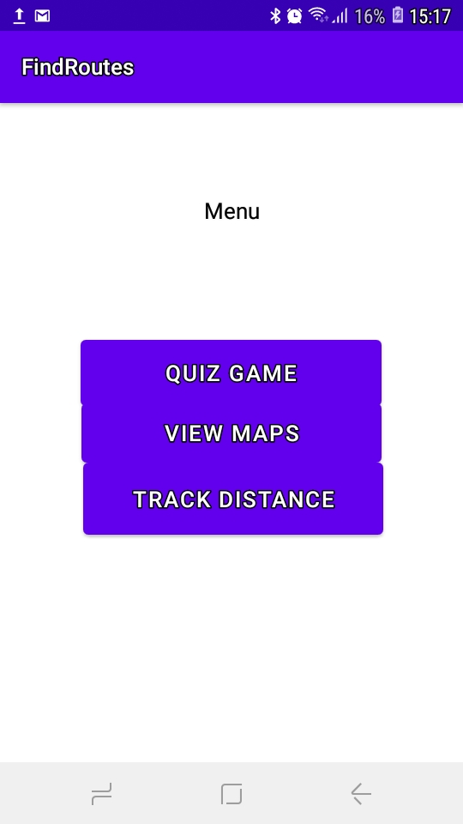
12:38
Screen Description and Purpose
This is the first screen that the user shall see after successfully logging into the FindRoutes mapping android application. The FindRoutes mapping android application is an online mapping tool so the user has to have internet connectivity to be able to interact with the different application components. Th user has the option to select between the three categories that the android application has, the user can play a quiz game, the user can view maps to find different locations on the map and the user can track the distance between two places by clicking the ‘Track Distance’ button on this screen.

Slide 5
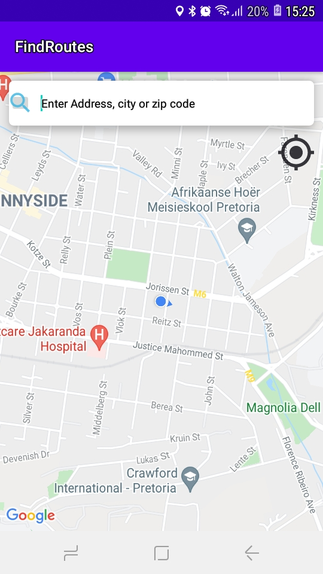
12:38
Screen Description and Purpose
When the user clicks the ‘view maps’ button, the user is directed to the map page where the user can search for different places, the user can search for different places by entering the place name in the search bar of the page to search the specific place they want. If the user wants to view their current location on the map, the user must click the big black dot on the screen to view their current location and the user can also find out information about a particular place by clicking on the icon of the searched place or chosen place on the map.

Slide 6
12:38
Screen Description and Purpose
The FindRoutes mapping android application promotes easy to use features meaning the user can click on the back button of their device to navigate to the different sections of the application.
The user has the ability to click on the landmark that they see displayed on the screen to see more information about that landmark.

Slide 7
12:38
Screen Description and Purpose
when the user clicks ‘track distance’ button on the main menu, the user can add save 3 favorite address and view the database saved addresses that they have chosen as their favorite.

Slide 8
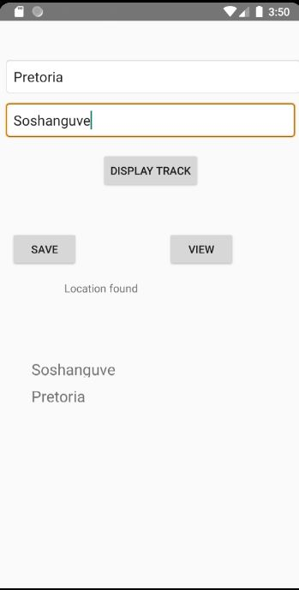
12:38
Screen Description and Purpose
When the user clicks the ‘Track distance’ button the user is directed to the track distance page, in this page the user can save 4 address by entering them in the textboxes and clicking the ‘save’ button, the user can track the distance between 2 locations by entering the location addresses and clicking the ‘display track’ button, and the user can display the saved addresses by pressing the ‘view’ button,
The user will then see the saved locations appear in the device screen as shown in the diagram on the left. The FindRoutes mapping android application promotes easy to use features meaning the user can click on the back button of their device to navigate to the different sections of the application.

Slide 9
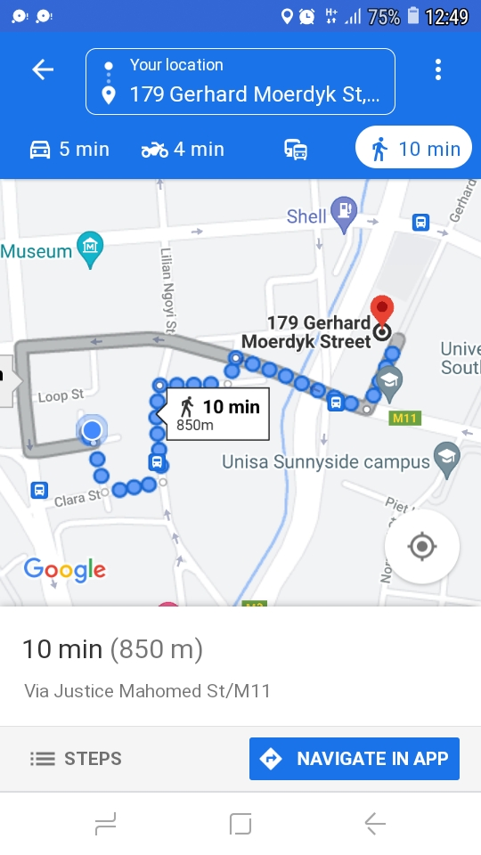
12:38
Screen Description and Purpose
When the user has entered 2 addresses they would like to calculate the distance of, the user must click the ‘display track ’ button and they will be re-directed to this page where the user will see the distance between the 2 entered locations in the ‘track distance’ page.

